Slide 1

UE19CS204 - Web Technologies
Mini Project
MERN Chat App
Section - A
Akanksha Akkihal - PES1UG19CS039
Aman Kumar M - PES1UG19CS050
GitHub Link : https://github.com/amankumarm/MERN-chat-app

Slide 2
ABSTRACT
We have developed a text and video chat application using MERN stack.
Our aim is to connect the people and help them expand their network.
Our App has a smooth user experience and is easy to use. It has a responsive web design and has two features i.e. Text Chat and Video chat.
HASHTAG.US

Slide 3
—HASHTAG.US
Be connected to the world. Expand your network, your network is your net worth

Slide 4

TECHNOLOGIES USED
Additional libraries
React styled components
React Bootstrap
Socket.io
PeerJS
Webpack
Uuid
Axios

Slide 5
THE TEAM
AKANKSHA AKKIHAL
AMAN KUMAR M
Landing Page
Video Chat component
Text Chat component
Integration of frontend and backend
Webpack

Slide 6
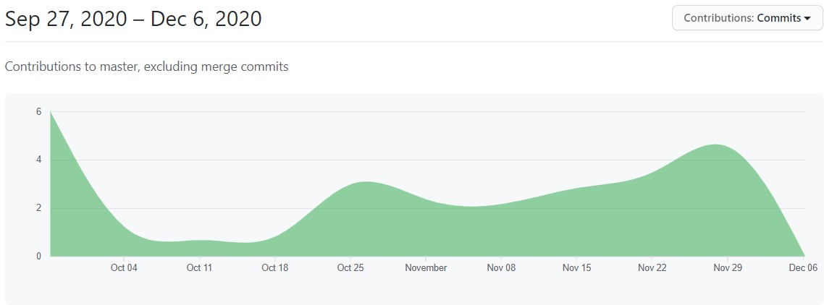
OUR TIMELINE
WEEK 5-6
FINAL
VERSION
LEARNING PHASE
WEEK 3-4
WEEK 7-8
Week 1-2 : Deciding the components , web design and getting used to GItHub
Landing Page , text and video chat components done
Text and Video chat components started
Integration of components, routing and final styling

Slide 7
THANK YOU

